Slide 1
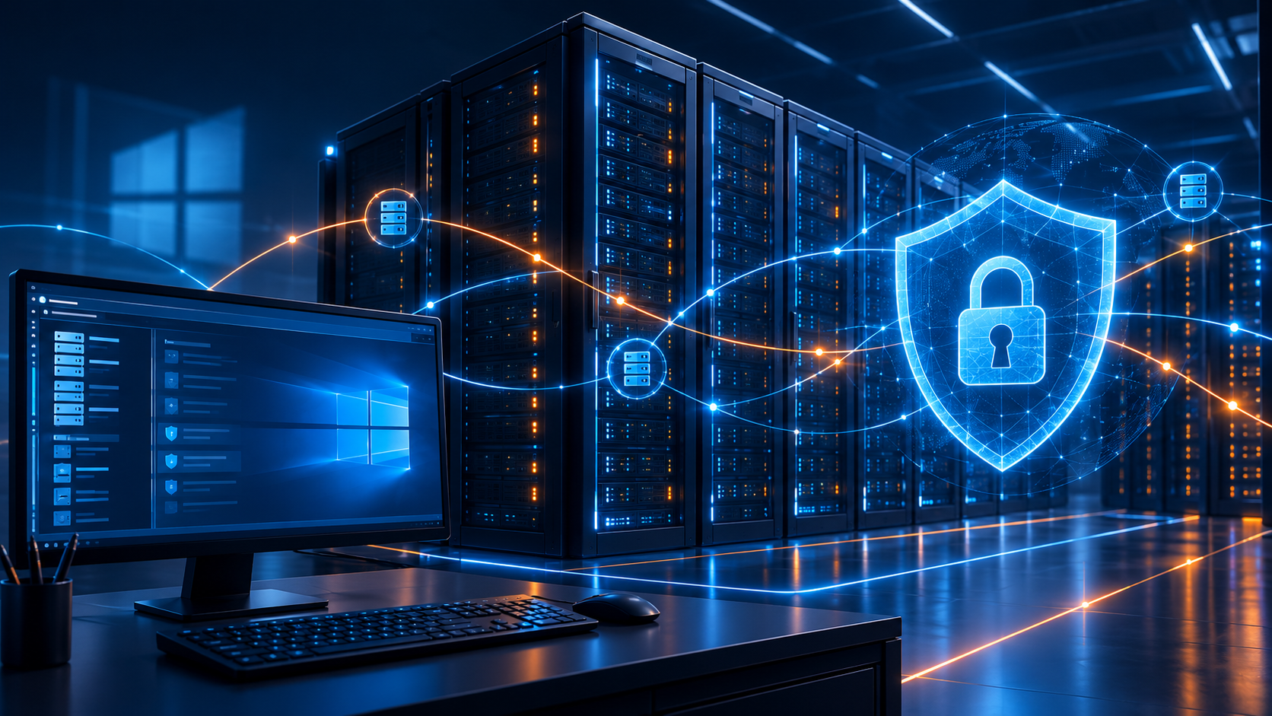
Server Administration
for Cyber Security
Week 1: Server operating systems and secure infrastructure foundations
SCQF Level 8 / HND
J27P 35
Freeman Industries Secure Infrastructure Project

Slide 2

Why this unit matters
The unit is about designing, implementing and maintaining secure server infrastructure.
Server administration is security work
Servers hold the services that users depend on: identity, files, applications, network services and logs.
A poorly designed server estate can make a business fragile even when individual machines appear to work.
Security must be planned before installation, because later fixes are usually less reliable and harder to prove.
At Level 8, the aim is not only to configure settings, but to justify, test and evaluate professional choices.
Core unit themes: Design securely → Implement carefully → Maintain and improve.

Slide 3
The server administrator’s role
A server administrator manages business outcomes, not just machines.
Availability
Identity
Data
Evidence
Keep services usable
Control who can sign in
Protect storage and access
Record what changed
Day-to-day responsibilities
Professional judgement
Configure roles and features safely.
Apply updates and review logs.
Manage accounts, permissions and access.
Test backup, restore and service health.
Use least privilege and change control.
Identify risks before implementing changes.
Select appropriate tools rather than the easiest tool.
Explain technical decisions to others.
The role combines technical skill, risk awareness, communication and accountability.

Slide 4
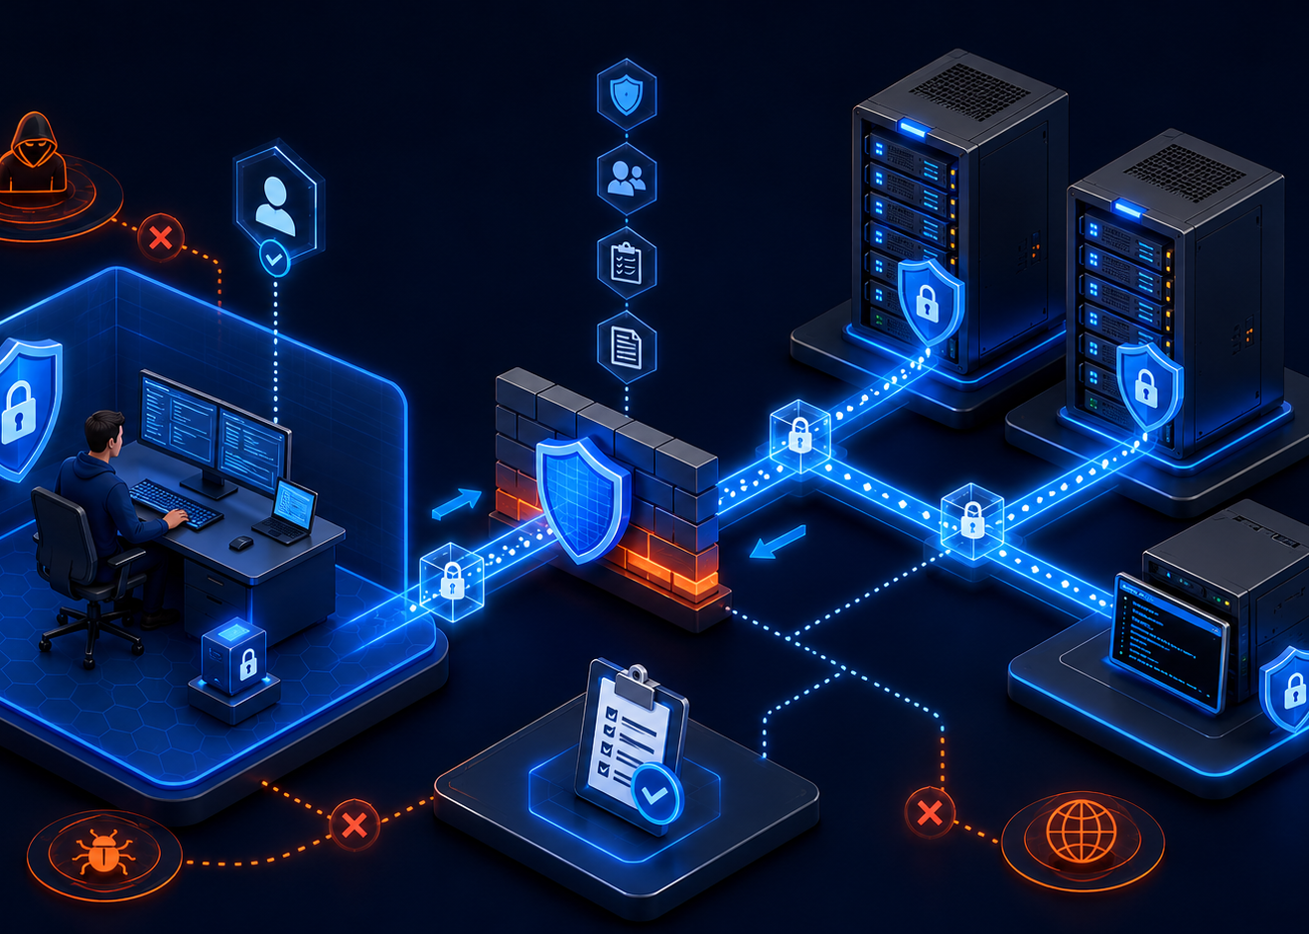
What makes a server a server?
A server provides a service that other systems depend on.
A server is defined by its role
It listens for requests from clients or other servers.
It often runs background services without a user sitting at the keyboard.
It supports many users or systems at the same time.
It should be managed, monitored, backed up and secured as a critical asset.
Client example
Server example
A laptop requests a file, web page, IP address or authentication token.
A domain controller, DNS server, file server or web server supplies the service.
Important: a “server” can be physical, virtual or cloud-hosted. The role matters more than the box.

Slide 5
Client/server architecture
Most business networks are built around clients requesting services from central systems.
Client
Server service
Result
Allowed response,
denied request,
or logged event
User workstation
or application
DNS, files, identity,
web or database
Typical flow
1. Client sends a request.
2. Server checks identity, permissions, policy and service state.
3. Server responds and records useful log evidence.
Security question: should this request be allowed, blocked, limited, logged or investigated?

Slide 6
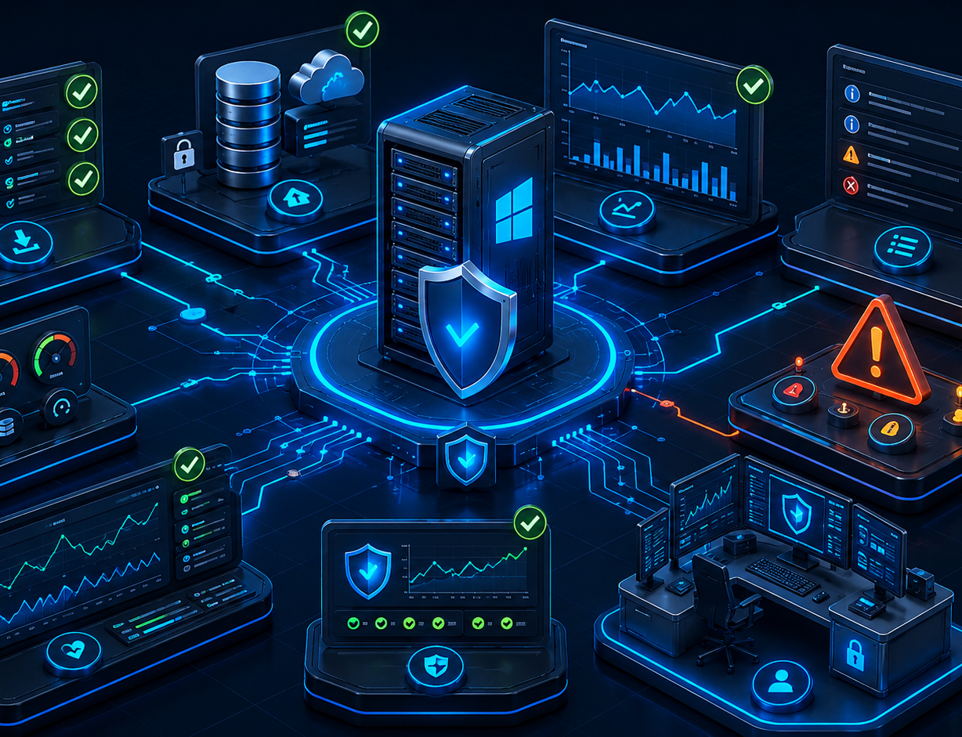
Server operating systems
A server OS is built to host services, enforce policy and support remote administration.
Roles and features allow the same OS to act as a domain controller, DNS server, DHCP server, file server, web server, certificate authority or virtualisation host.
Services run in the background and should be configured to start, stop, log and recover predictably.
Remote management is normal, so firewall rules, trusted credentials and encrypted protocols matter.
Logs, updates, scheduled tasks and baselines are part of the operating system’s security lifecycle.
Desktop OS focus
Server OS focus
Interactive user experience, local apps and personal productivity.
Service reliability, remote administration, roles, logs and central security.

Slide 7
Workgroup vs centrally managed infrastructure
Freeman Industries is moving from inconsistent local control to centralised, auditable management.
Workgroup-style environment
Domain-managed environment
Problems this often creates
Improvements when designed well
Local accounts are managed separately on each machine.
Password settings and administrator access are inconsistent.
It is difficult to disable a leaver everywhere.
Support actions can be hard to audit.
Central identity and authentication.
Group Policy for users and computers.
Role-based access and delegated administration.
Consistent logging, review and account lifecycle control.
Central management does not automatically make a network secure. It gives administrators better controls to design, apply, test and review.

Slide 8
Common server roles in this project
Each role provides a different business service and creates different security responsibilities.
AD DS
DNS
Identity, authentication and directory structure
Name resolution and service location
DHCP
File Services
Managed IP addressing and options
Shared data, permissions and auditing
IIS / Web
PKI
Application hosting, bindings and logs
Certificates, trust and encrypted services
Hyper-V
Monitoring / Backup
Virtual machines and isolated networks
Maintenance, recovery and assurance
Design question: which services should be together, separated, replicated or protected more heavily?

Slide 9
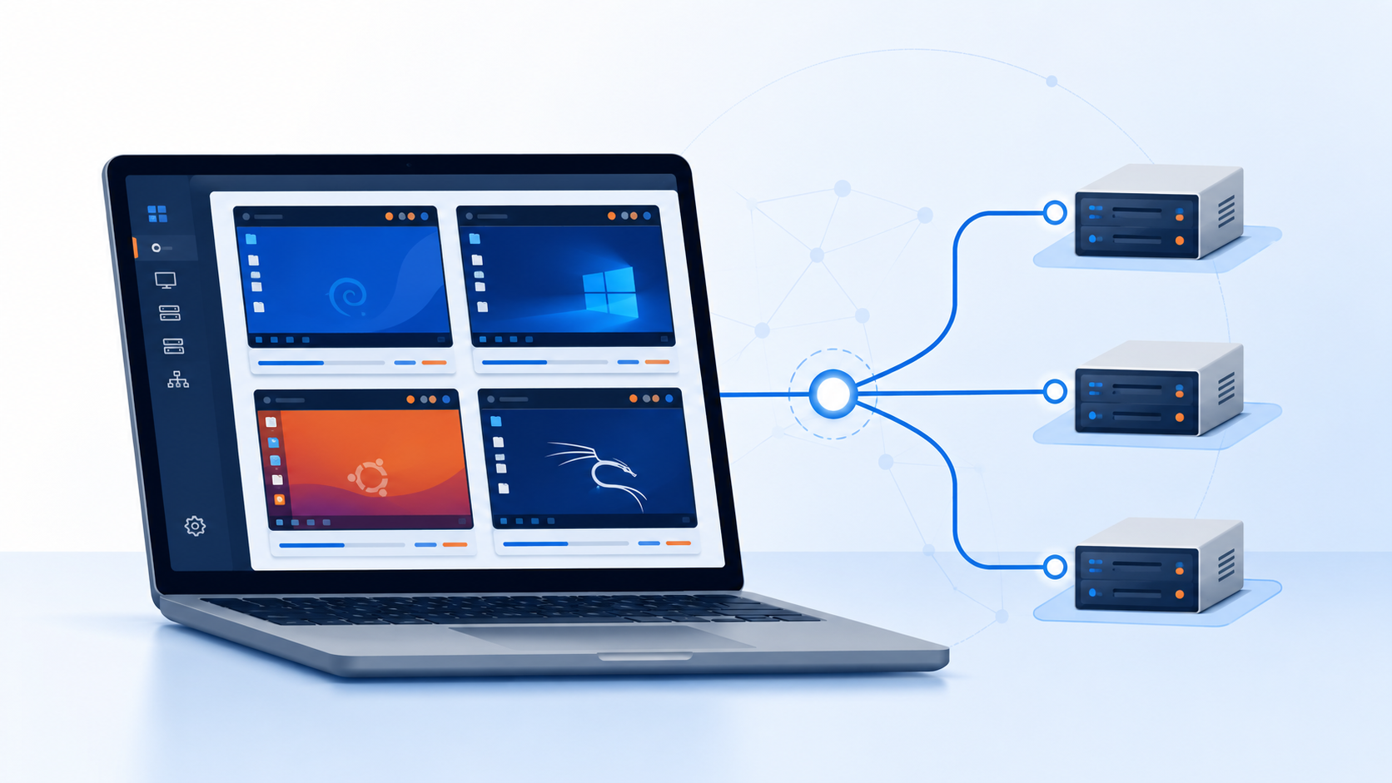
Physical, virtual and cloud-hosted servers
The same service can be delivered through different infrastructure models.
Physical server
Dedicated hardware. Clear boundaries, but hardware failure affects services unless resilience is planned.
Virtual machine
A server running on a hypervisor. Easy to test, copy and recover, but depends on host security and storage.
Cloud-hosted service
Runs on someone else’s platform. Scales well, but still needs identity, access, configuration and monitoring.
Virtualisation is useful for learning because it lets you build a realistic server estate without changing the real college network.

Slide 10
The safe virtual lab environment
All practical server work must stay inside an isolated lab environment.
Use isolated virtual networks so testing does not affect real users or production systems.
Use the project namespace corp.freemanindustries.com for the domain and server names.
Save virtual machines and virtual-lab files to your own personal SSD, not to college computer drives.
Use fictional users, test files and lab-only credentials. Never capture passwords, private keys or recovery keys in documentation.
Internal virtual switch
External access
Used for systems that should only communicate inside the lab.
Use with care. Decide exactly what traffic should leave the lab.

Slide 11
Secure infrastructure design mindset
Security is not one feature. It is a chain of design decisions.
Confidentiality
Integrity
Availability
Only authorised access
Accurate and trusted data
Services work when needed
Reduce attack surface by removing unnecessary roles, protocols, permissions and exposure.
Separate roles so that compromise of one service does not automatically compromise everything.
Use least privilege for users, administrators, service accounts and delegated tasks.
Build defence in depth so monitoring, permissions, backups and network boundaries work together.

Slide 12
The layered view of a secure server estate
A resilient design has several controls, not a single “security box”.
Users and endpoints
Identity and policy
Network services
Standard accounts, patching, device policies
AD DS, groups, OU design, GPOs
DNS, DHCP, routing, segmentation
Server roles
Data and recovery
Operations
File, web, PKI, monitoring, Hyper-V
Permissions, quotas, backups, restore tests
Logs, change control, incident response
A strong design assumes that one control may fail and plans how the next layer will limit damage.

Slide 13

Freeman Industries scenario
The scenario provides business context for design decisions throughout the unit.
Freeman Industries is a growing Scottish engineering and technology company based in Livingston.
It designs specialist products, supports business customers and operates a small customer information website.
The company has approximately 75 staff and is expected to grow to around 100 staff over the next two years.
David Freeman, IT Manager, needs a secure Windows Server 2025 infrastructure tested inside an isolated virtual lab.
The scenario deliberately gives requirements, not a single fixed build. Professional choices must be justified.

Slide 14
Business departments create different security needs
Access should reflect job role, business requirement and sensitivity of data.
Executive
Management reports, confidential information
Finance / HR
Restricted personnel and financial records
Engineering
Large project files, controlled software, reliable storage
Sales / Customer
Shared customer documents and website access
Operations
Operational records and limited workstation privileges
IT
Tiered administration, monitoring and recovery access
Good infrastructure design converts business structure into groups, permissions, policies and documentation.

Slide 15
Current risk picture
Every identified problem should become a design requirement or control.
Local accounts
Shared admin
Weak accountability and inconsistent passwords
No clear audit trail and excessive privilege
Flat network
Uncontrolled files
Compromise can spread more easily
Permissions and recovery become unreliable
Irregular backups
Weak documentation
Restore may fail when needed
Unsafe changes and information leakage
Risk thinking: What can go wrong? How likely is it? What is the impact? What control reduces the risk?

Slide 16
From business requirements to technical requirements
A requirements register helps turn vague problems into testable design decisions.
Need
Risk if ignored
Likely control
How to test
Central logon
Accounts remain inconsistent
AD DS with clear naming
Join client and authenticate
Reliable names
Services become hard to find
DNS zones and records
Forward/reverse lookups
Controlled software
Malware and support risk
GPO/application control
Attempt standard-user install
Protected files
Sensitive data exposure
Group-based permissions
Positive/negative access tests
At HND level, a setting is stronger evidence when it is linked to a requirement and supported by a test result.

Slide 17
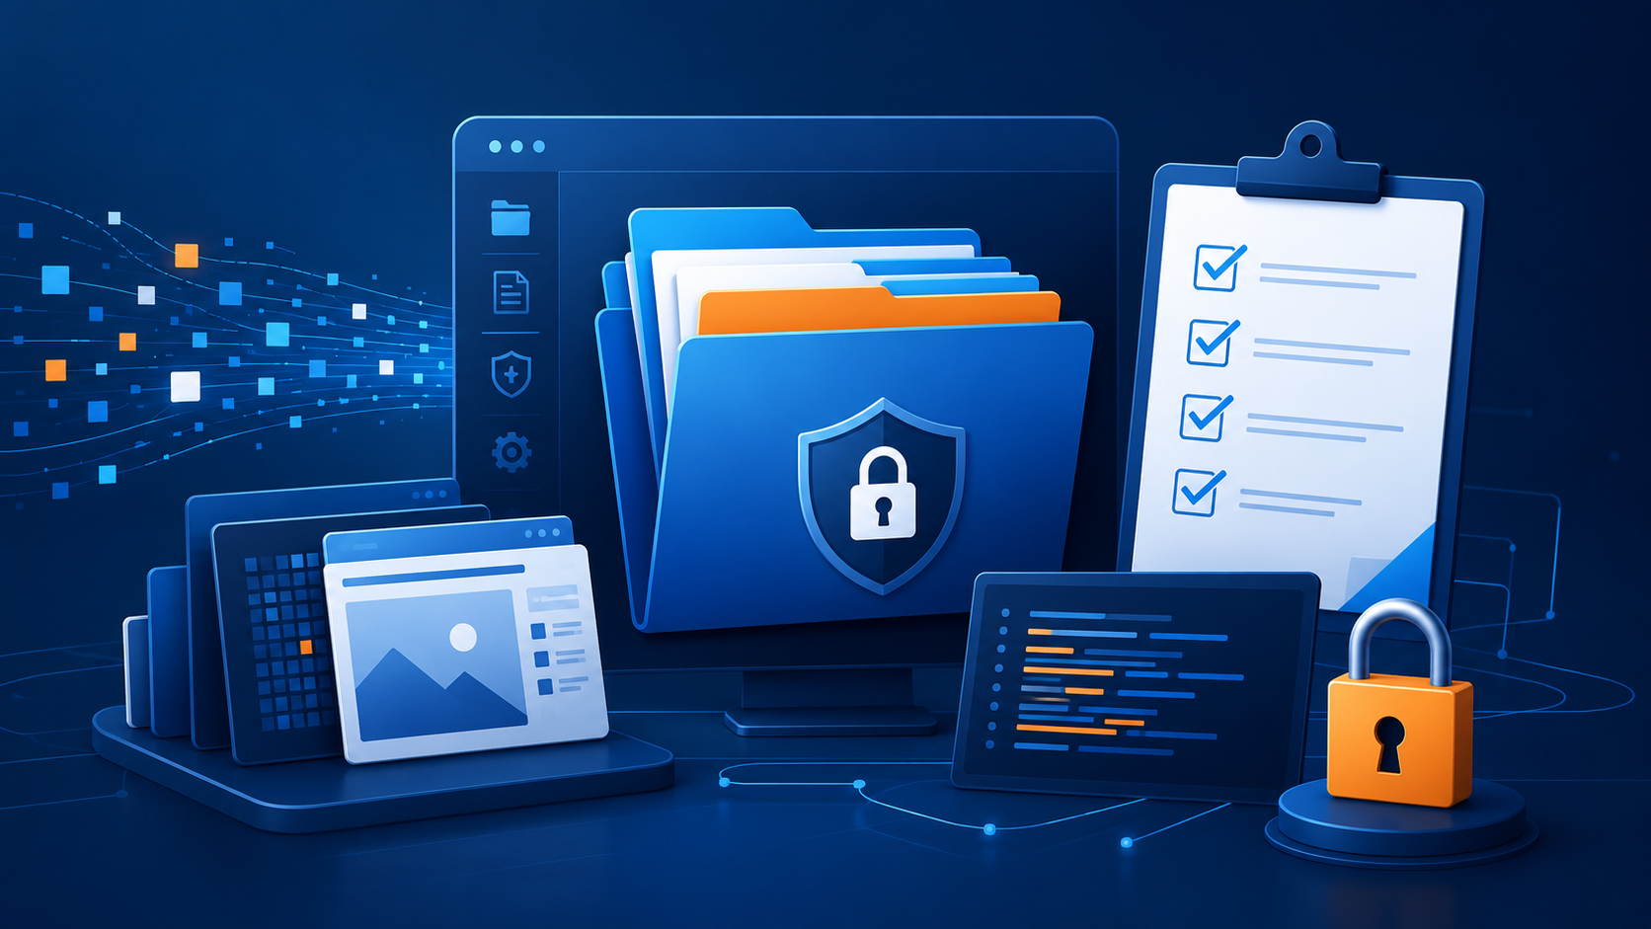
Professional documentation and technical evidence
Documentation is part of secure administration, not an afterthought.
Record what was changed, why it was changed, who or what account performed the change and how it was tested.
Use diagrams, naming standards, configuration records, scripts, logs and clear explanations.
Screenshots are useful only when annotated and linked to a decision, configuration or test result.
Store sensitive technical documentation securely and avoid capturing passwords, private keys, recovery keys or real personal data.
Good evidence lets another administrator understand, reproduce and safely maintain the environment.

Slide 18
Ethics, boundaries and professional responsibility
A secure lab must be treated as though it contained real business systems.
Lab boundary
Test data only
Do not scan, test or reconfigure the college production network.
Use fictional accounts and files. Keep real personal or business data out of the lab.
Secrets stay secret
Least privilege
Do not record passwords, private keys, recovery keys or live credentials.
Use the minimum access required and keep standard and elevated use separate.
Accountability
Careful communication
Record meaningful changes and use named accounts wherever possible.
Explain risks without exposing sensitive technical details unnecessarily.
Security professionalism is shown by what you avoid doing as much as by what you configure.

Slide 19
Thinking at SCQF Level 8
Level 8 work involves explanation, judgement and evaluation.
Describe
Explain the scope and main features of the technology.
Apply
Use professional tools and techniques in a realistic scenario.
Justify
Give reasons for design choices and alternatives.
Evaluate
Test, interpret results and identify limitations or residual risk.
Communicate
Present complex information clearly to technical and non-technical audiences.
Aim for professional reasoning: “I chose this because… I tested it by… The limitation is…”

Slide 20
Week 1 concept map
The first week connects business context to the technical work that follows.
Scenario
→
Risks
→
Roles
→
Design
→
Build
→
Test
→
Maintain
Business context
What could go wrong
Services needed
Decisions and controls
Implementation choices
Evidence and assurance
Ongoing security
Understand
Design and configure
Prove and maintain
Analyse the organisation, users, risks and operating constraints.
Select services, placements and controls that match the business need.
Test expected and blocked behaviour, then document maintenance decisions.
Server administration is a cycle: understand the business, design controls, configure systems, prove the result and keep improving.

Slide 21
Moving into Week 2
Next, the focus moves from foundation knowledge to secure infrastructure design and server placement.
Security-by-design and the CIA triad in infrastructure planning.
Physical and logical server placement decisions.
Network segmentation, perimeter concepts and attack surface reduction.
First version of the Freeman Industries server estate, risk register and placement rationale.
Keep thinking like a professional administrator: every placement decision should have a security and operational reason.

